Slide 1
Mathematical Programming:
Modelling and Some Issues

Slide 2
Contents
Closed Feasible Region (less than or equal to)
Constraints via Matrix Operations
Chocolate Box Problem
Interpretation/Opinion/Preference
Extending the Model
Additional Modelling Tips

Slide 3
Blank Slide

Slide 4
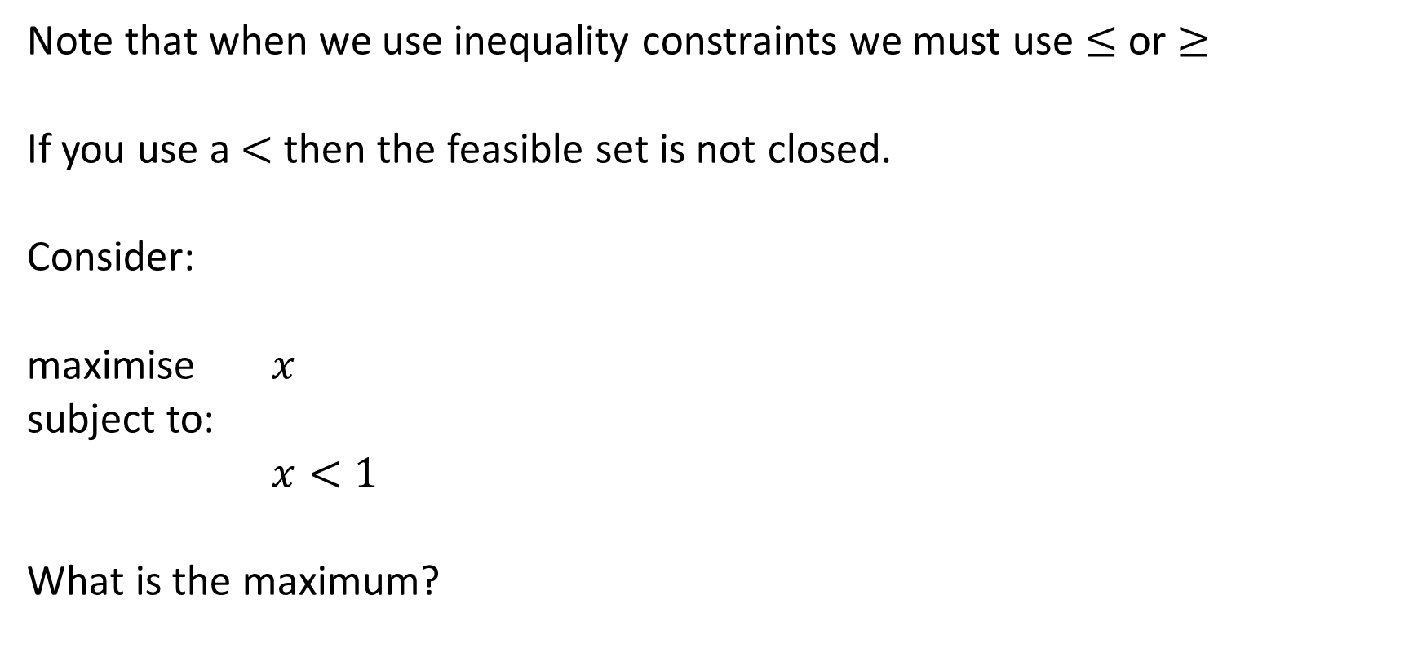
Less than or equal to
Note that when we use inequality constraints we must use $≤$ or $≥$
If you use a $<$ then the feasible set is not closed.
Consider:
maximise $x$
subject to:
$x<1$
What is the maximum?

Slide 5
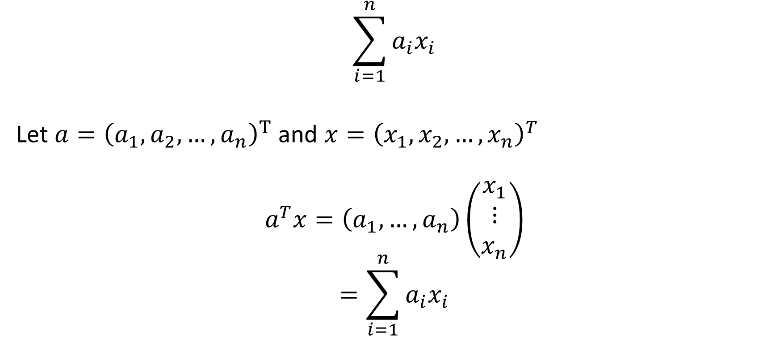
Constraints via Matrix Operations
$$\sum_{i=1}^{n}{a_{i}x_{i}}$$
Let $a={\left(a_{1},a_{2},…,a_{n}\right)}^{T}$ and $x={\left(x_{1},x_{2},…,x_{n}\right)}^{T}$
$$a^{T}x=\left(a_{1},…,a_{n}\right)\left(\begin{matrix}x_{1} \\ ⋮ \\ x_{n}\end{matrix}\right)$$
$$=\sum_{i=1}^{n}{a_{i}x_{i}}$$

Slide 6
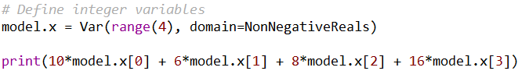


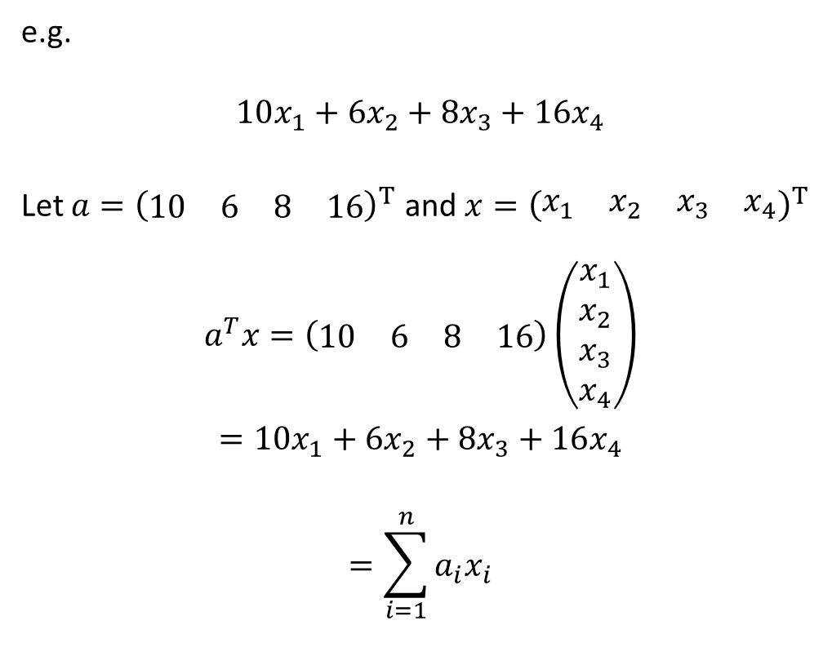
Linear Expressions in Pyomo
e.g.
$$10x_{1}+6x_{2}+8x_{3}+16x_{4}$$
Let $a={\left(\begin{matrix}10 & 6 & 8 & 16\end{matrix}\right)}^{T}$ and $x={\left(\begin{matrix}x_{1} & x_{2} & x_{3} & x_{4}\end{matrix}\right)}^{T}$
$$a^{T}x=\left(\begin{matrix}10 & 6 & 8 & 16\end{matrix}\right)\left(\begin{matrix}x_{1} \\ x_{2} \\ x_{3} \\ x_{4}\end{matrix}\right)$$
$$=10x_{1}+6x_{2}+8x_{3}+16x_{4}$$
$$=\sum_{i=1}^{n}{a_{i}x_{i}}$$
Define either manually or using sum
Both print out the following:

Slide 7
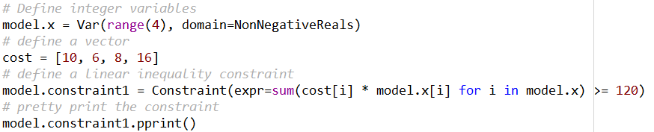
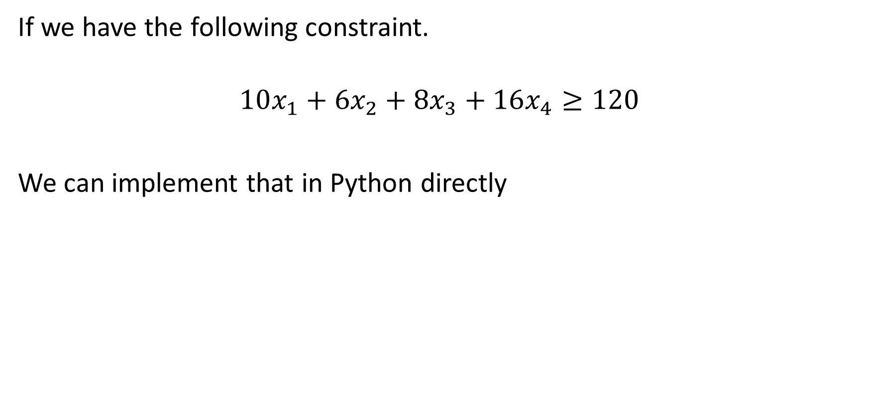
Linear Constraints in Pyomo
If we have the following constraint.
$$10x_{1}+6x_{2}+8x_{3}+16x_{4}≥120$$
We can implement that in Python directly
Output:

Slide 8
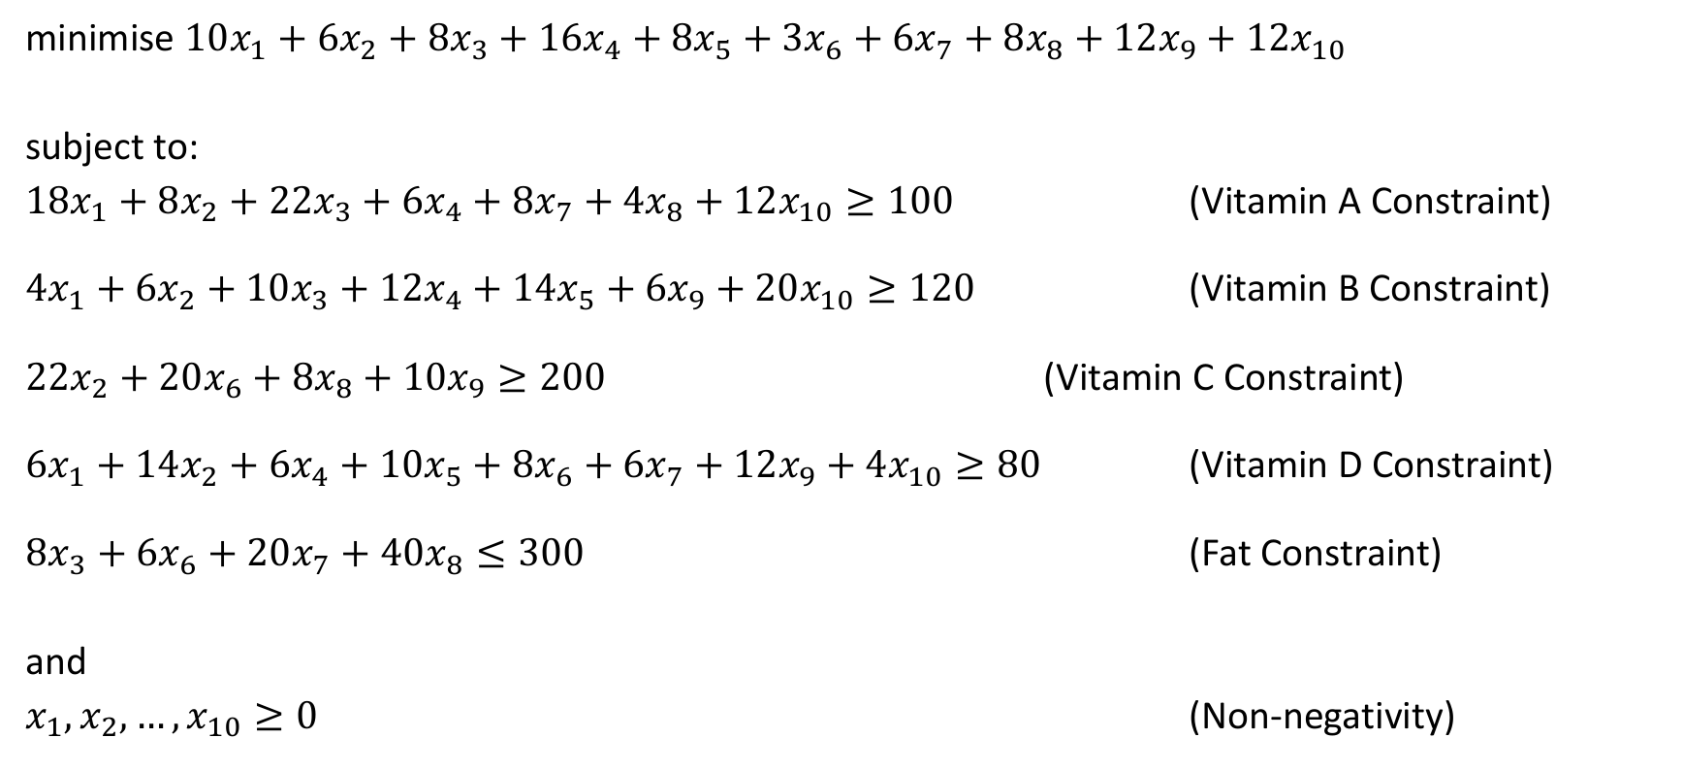
Diet Problem (Week 2 Tutorial Q6a)
minimise $10x_{1}+6x_{2}+8x_{3}+16x_{4}+8x_{5}+3x_{6}+6x_{7}+8x_{8}+12x_{9}+12x_{10}$
subject to:
$18x_{1}+8x_{2}+22x_{3}+6x_{4}+8x_{7}+4x_{8}+12x_{10}≥100$ (Vitamin A Constraint)
$4x_{1}+6x_{2}+10x_{3}+12x_{4}+14x_{5}+6x_{9}+20x_{10}≥120$ (Vitamin B Constraint)
$22x_{2}+20x_{6}+8x_{8}+10x_{9}≥200$ (Vitamin C Constraint)
$6x_{1}+14x_{2}+6x_{4}+10x_{5}+8x_{6}+6x_{7}+12x_{9}+4x_{10}≥80$ (Vitamin D Constraint)
$8x_{3}+6x_{6}+20x_{7}+40x_{8}≤300$ (Fat Constraint)
and
$x_{1},x_{2},…,x_{10}≥0$ (Non-negativity)

Slide 9
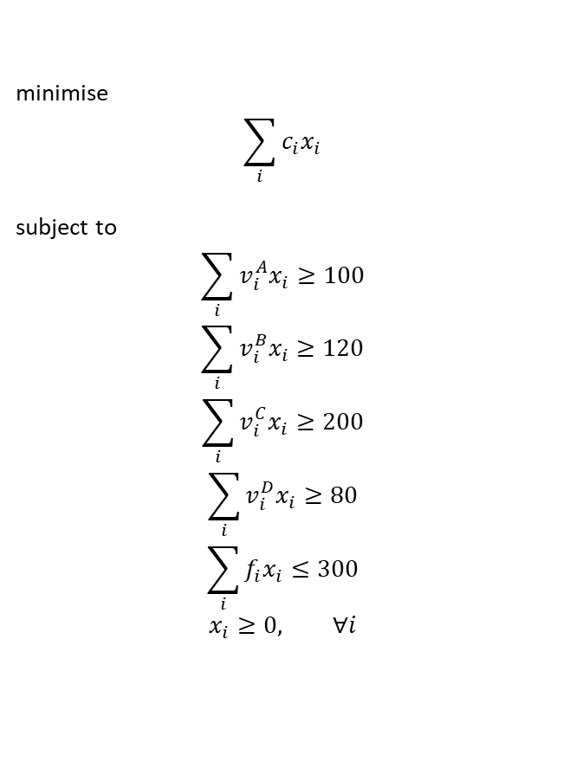
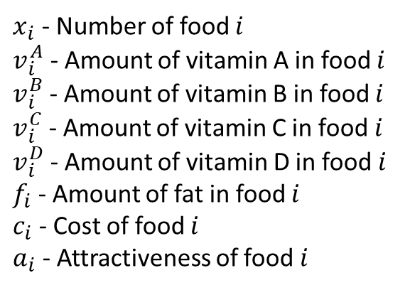
Diet Problem (Week 2 Tutorial Q6a)
Food | Vitamin A | Vitamin B | Vitamin C | Vitamin D | Fat | Cost | Attractiveness
1 | 18 | 4 | - | 6 | - | 10 | 6
2 | 8 | 6 | 22 | 14 | - | 6 | 1
3 | 22 | 10 | - | - | 8 | 8 | 5
4 | 6 | 12 | - | 6 | - | 16 | 5
5 | - | 14 | - | 10 | - | 8 | 6
6 | - | - | 20 | 8 | 6 | 3 | 4
7 | 8 | - | - | 6 | 20 | 6 | 10
8 | 4 | - | 8 | - | 40 | 8 | 10
9 | - | 6 | 10 | 12 | - | 12 | 6
10 | 12 | 20 | - | 4 | - | 12 | 7
 | Minimum | Maximum
Vitamin A | 100 | -
Vitamin B | 120 | -
Vitamin C | 200 | -
Vitamin D | 80 | -
Fat | - | 300
minimise
$$\sum_{i}{c_{i}x_{i}}$$
subject to
$$\sum_{i}{v_{i}^{A}x_{i}}≥100$$
$$\sum_{i}{v_{i}^{B}x_{i}}≥120$$
$$\sum_{i}{v_{i}^{C}x_{i}}≥200$$
$$\sum_{i}{v_{i}^{D}x_{i}}≥80$$
$$\sum_{i}{f_{i}x_{i}}≤300$$
$$x_{i}≥0, ∀i$$
$x_{i}$ - Number of food $i$
$v_{i}^{A}$ - Amount of vitamin A in food $i$
$v_{i}^{B}$ - Amount of vitamin B in food $i$
$v_{i}^{C}$ - Amount of vitamin C in food $i$
$v_{i}^{D}$ - Amount of vitamin D in food $i$
$f_{i}$ - Amount of fat in food $i$
$c_{i}$ - Cost of food $i$
$a_{i}$ - Attractiveness of food $i$

Slide 10
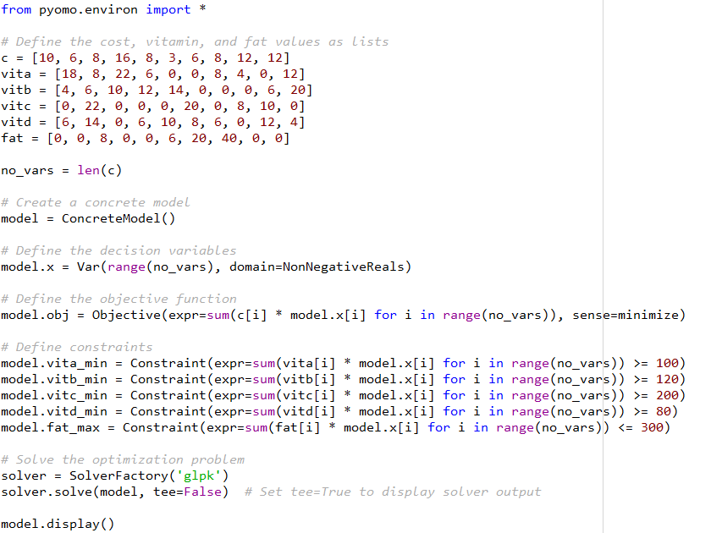
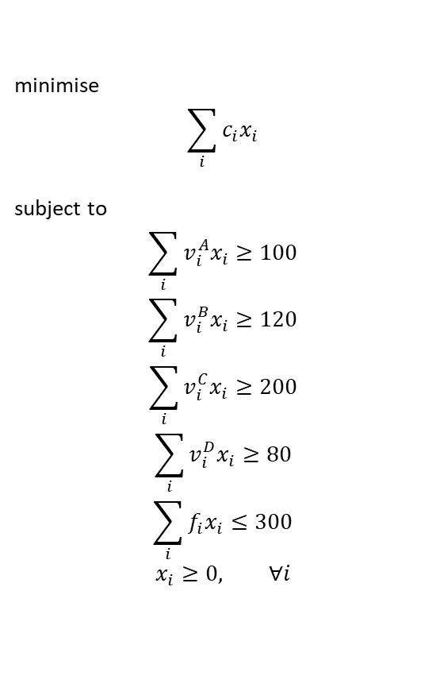
Q6a Solution in Pyomo
minimise
$$\sum_{i}{c_{i}x_{i}}$$
subject to
$$\sum_{i}{v_{i}^{A}x_{i}}≥100$$
$$\sum_{i}{v_{i}^{B}x_{i}}≥120$$
$$\sum_{i}{v_{i}^{C}x_{i}}≥200$$
$$\sum_{i}{v_{i}^{D}x_{i}}≥80$$
$$\sum_{i}{f_{i}x_{i}}≤300$$
$$x_{i}≥0, ∀i$$

Slide 11
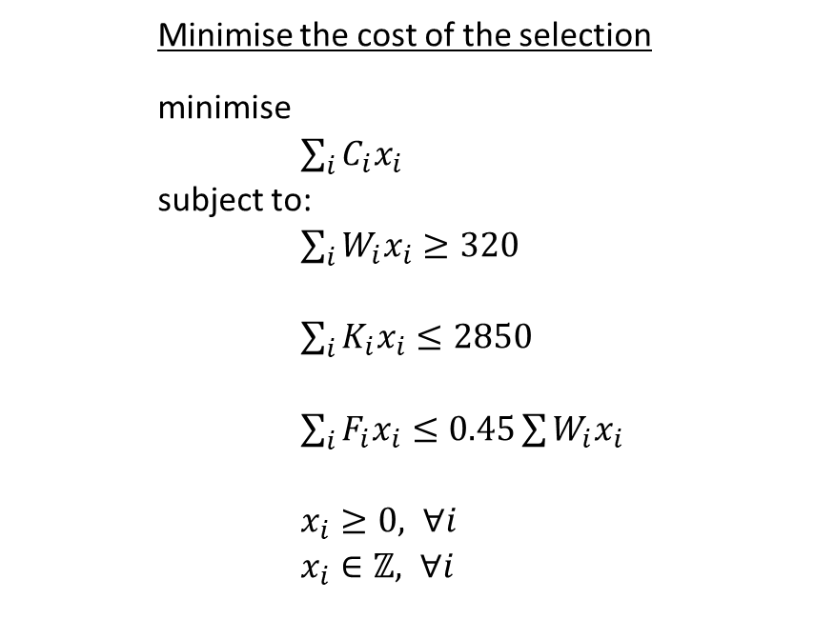
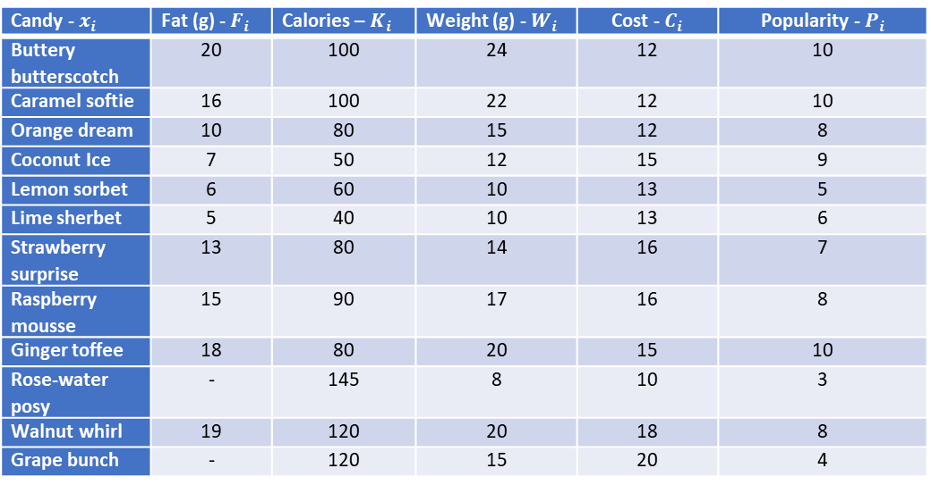
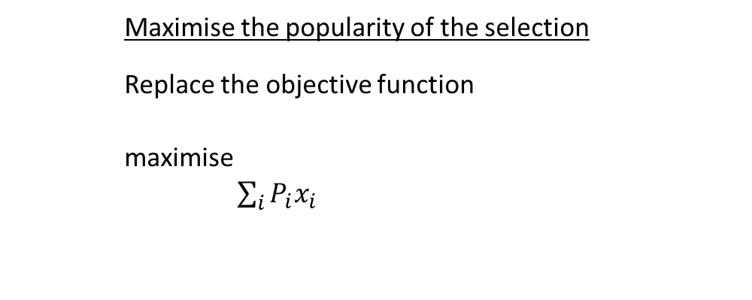
Chocolate Box Tutorial Question
Minimise the cost of the selection
minimise
$\sum_{i}{C_{i}x_{i}}$
subject to:
$\sum_{i}{W_{i}x_{i}≥320}$
$\sum_{i}{K_{i}x_{i}≤2850}$
$\sum_{i}{F_{i}x_{i}≤0.45\sum{W_{i}x_{i}}}$
$x_{i}≥0, ∀i$
$x_{i}∈ℤ, ∀i$
Candy - $x_{i}$ | Fat (g) - $F_{i}$ | Calories – $K_{i}$ | Weight (g) - $W_{i}$ | Cost - $C_{i}$ | Popularity - $P_{i}$
Buttery butterscotch | 20 | 100 | 24 | 12 | 10
Caramel softie | 16 | 100 | 22 | 12 | 10
Orange dream | 10 | 80 | 15 | 12 | 8
Coconut Ice | 7 | 50 | 12 | 15 | 9
Lemon sorbet | 6 | 60 | 10 | 13 | 5
Lime sherbet | 5 | 40 | 10 | 13 | 6
Strawberry surprise | 13 | 80 | 14 | 16 | 7
Raspberry mousse | 15 | 90 | 17 | 16 | 8
Ginger toffee | 18 | 80 | 20 | 15 | 10
Rose-water posy | - | 145 | 8 | 10 | 3
Walnut whirl | 19 | 120 | 20 | 18 | 8
Grape bunch | - | 120 | 15 | 20 | 4
The selection chosen must weigh at least 320g
Total fat content by weight must be at most 45% of the total weight of the selection.
Calorific value of the selection must be at most 2850 calories.
Maximise the popularity of the selection
Replace the objective function
maximise
$\sum_{i}{P_{i}x_{i}}$

Slide 12
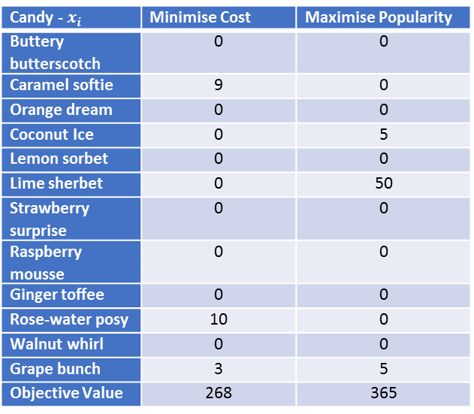
Chocolate Box Tutorial Results
Candy - $x_{i}$ | Minimise Cost | Maximise Popularity
Buttery butterscotch | 0 | 0
Caramel softie | 9 | 0
Orange dream | 0 | 0
Coconut Ice | 0 | 5
Lemon sorbet | 0 | 0
Lime sherbet | 0 | 50
Strawberry surprise | 0 | 0
Raspberry mousse | 0 | 0
Ginger toffee | 0 | 0
Rose-water posy | 10 | 0
Walnut whirl | 0 | 0
Grape bunch | 3 | 5
Objective Value | 268 | 365
What do we think of these selections?
Issues
Variety
Weight of maximising popularity is 635g. Nearly double the minimum weight of 320g
What if we care about both cost and popularity?

Slide 13
Interpretation
Your interpretation of the problem is important!
If you miss something in the model it can lead to answers that don’t make sense in the real world.
Your interpretation of the solution is important!
Often the answers point out the issues in your model.
Thus, modelling is an iterative process, you should keep improving your model to better reflect reality where possible.
Better models lead to better predictions and decisions!

Slide 14
Opinion and Preference
Your opinion and preferences matter!
Perhaps you/business really needs to save money, so you decide minimising cost is important.
Maybe you aren’t a fan of variety and would prefer a smaller selection, or the selection chooses your favourite chocolate. Be aware of personal bias!

Slide 15
Sometimes there is more to the story
Let’s revisit the previous comment.
Perhaps you/business really needs to save money, so you decide minimising cost is important.
What if this leads to a substandard product and this fails to sell. In this case you haven’t necessarily saved money, but lost it!
Modelling well, whether it be Linear Programming, Simulation, Optimisation is hard!

Slide 16
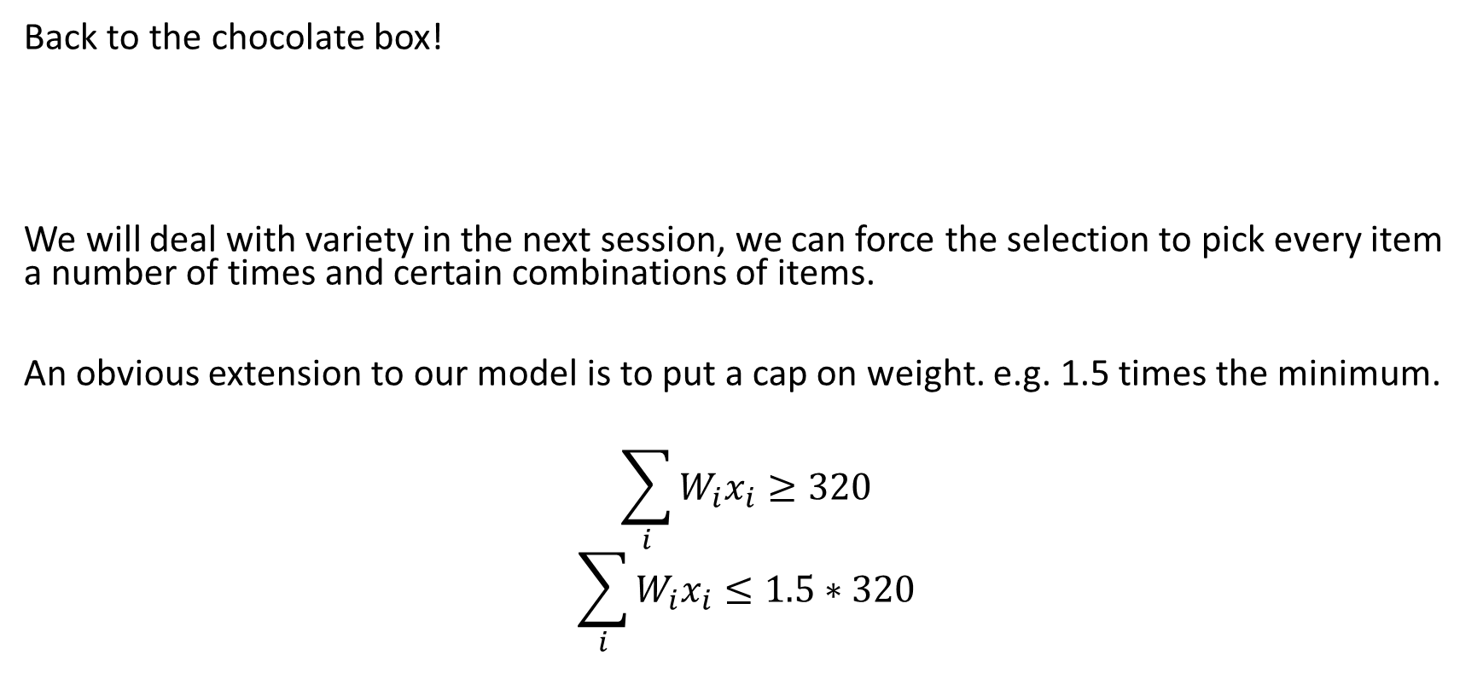
Extending the Model
Issues
Variety
Weight of maximising popularity is 635g. Nearly double the minimum weight of 320g
What if we care about both cost and popularity?
Back to the chocolate box!
We will deal with variety in the next session, we can force the selection to pick every item a number of times and certain combinations of items.
An obvious extension to our model is to put a cap on weight. e.g. 1.5 times the minimum.
$$\sum_{i}{W_{i}x_{i}≥320}$$
$$\sum_{i}{W_{i}x_{i}≤1.5∗320}$$

Slide 17
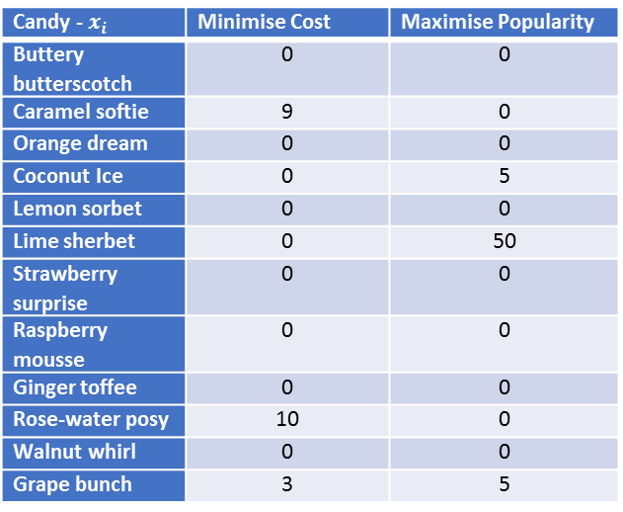
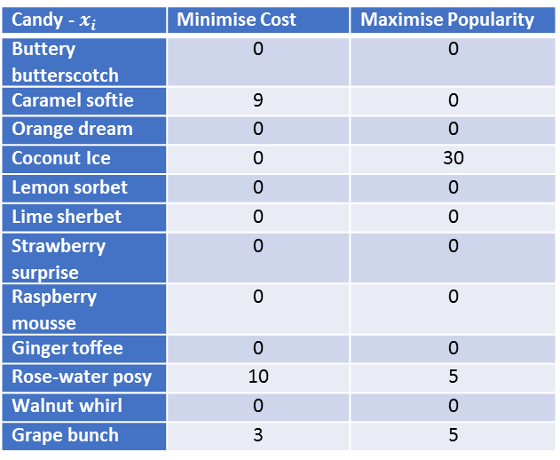
Chocolate Box Tutorial Results
No Weight Cap
With Weight Cap
Candy - $x_{i}$ | Minimise Cost | Maximise Popularity
Buttery butterscotch | 0 | 0
Caramel softie | 9 | 0
Orange dream | 0 | 0
Coconut Ice | 0 | 5
Lemon sorbet | 0 | 0
Lime sherbet | 0 | 50
Strawberry surprise | 0 | 0
Raspberry mousse | 0 | 0
Ginger toffee | 0 | 0
Rose-water posy | 10 | 0
Walnut whirl | 0 | 0
Grape bunch | 3 | 5
Candy - $x_{i}$ | Minimise Cost | Maximise Popularity
Buttery butterscotch | 0 | 0
Caramel softie | 9 | 0
Orange dream | 0 | 0
Coconut Ice | 0 | 30
Lemon sorbet | 0 | 0
Lime sherbet | 0 | 0
Strawberry surprise | 0 | 0
Raspberry mousse | 0 | 0
Ginger toffee | 0 | 0
Rose-water posy | 10 | 5
Walnut whirl | 0 | 0
Grape bunch | 3 | 5
Why hasn’t it affected the Minimise Cost Model?
Because the weight of the optimal solution was already less than the cap!

Slide 18
Extending the Model
Issues
Variety
Weight of maximising popularity is 635g. Nearly double the minimum weight of 320g
What if we care about both cost and popularity?
How to deal with both cost and popularity?
Ideas?
Combine the objectives
  Ratio
  Weighted Objective

Slide 19
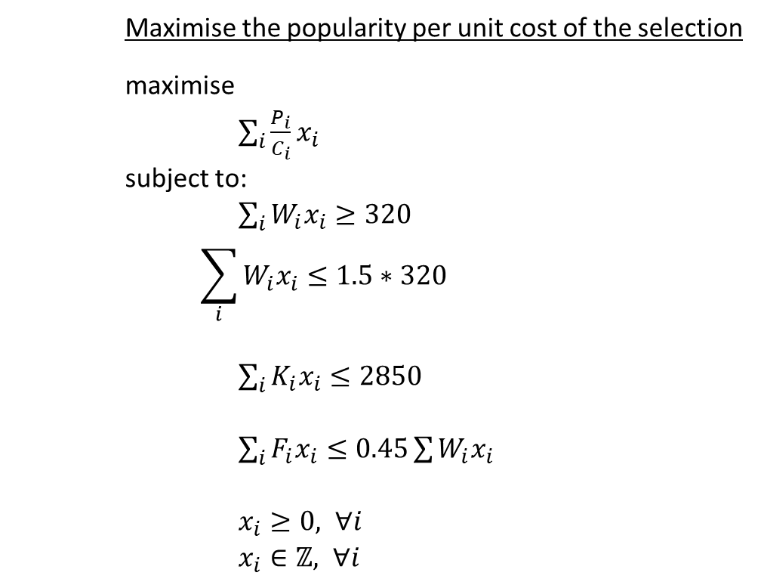
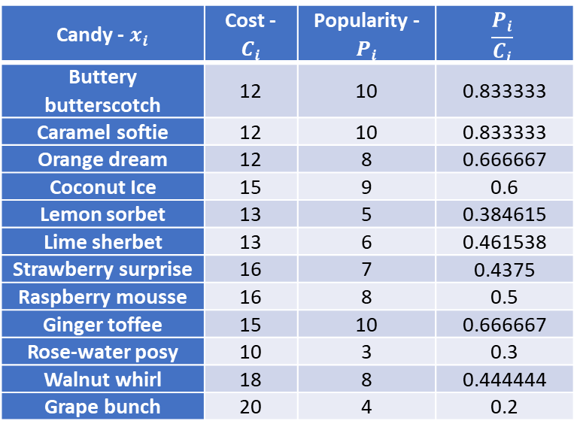
Ratio Objective
Maximise the sum of each candy’s popularity per unit cost
maximise
$\sum_{i}{\frac{P_{i}}{C_{i}}x_{i}}$
subject to:
$\sum_{i}{W_{i}x_{i}≥320}$
$$\sum_{i}{W_{i}x_{i}≤1.5∗320}$$
$\sum_{i}{K_{i}x_{i}≤2850}$
$\sum_{i}{F_{i}x_{i}≤0.45\sum{W_{i}x_{i}}}$
$x_{i}≥0, ∀i$
$x_{i}∈ℤ, ∀i$
Candy - $x_{i}$ | Cost - $C_{i}$ | Popularity - $P_{i}$ | $$\frac{P_{i}}{C_{i}}$$
Buttery butterscotch | 12 | 10 | 0.833333
Caramel softie | 12 | 10 | 0.833333
Orange dream | 12 | 8 | 0.666667
Coconut Ice | 15 | 9 | 0.6
Lemon sorbet | 13 | 5 | 0.384615
Lime sherbet | 13 | 6 | 0.461538
Strawberry surprise | 16 | 7 | 0.4375
Raspberry mousse | 16 | 8 | 0.5
Ginger toffee | 15 | 10 | 0.666667
Rose-water posy | 10 | 3 | 0.3
Walnut whirl | 18 | 8 | 0.444444
Grape bunch | 20 | 4 | 0.2

Slide 20
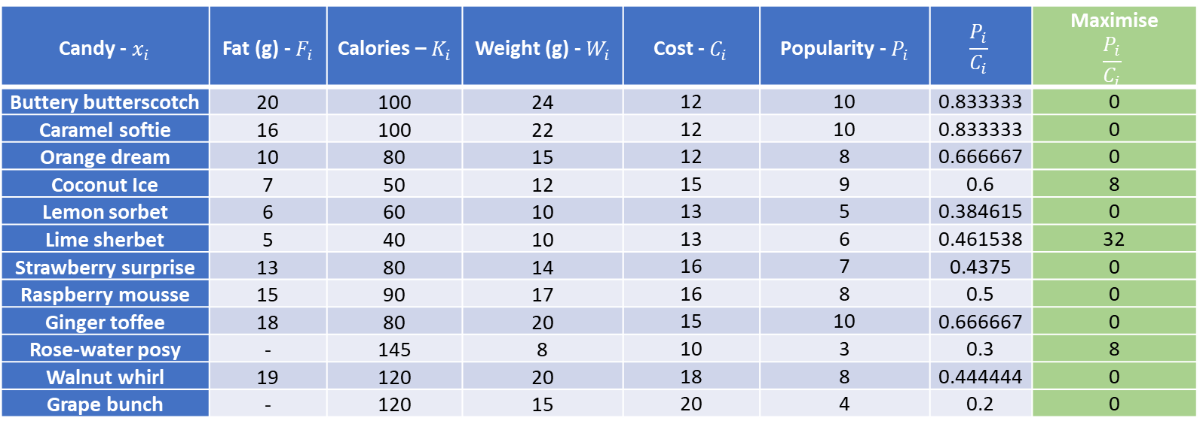
Result
Candy - $x_{i}$ | Fat (g) - $F_{i}$ | Calories – $K_{i}$ | Weight (g) - $W_{i}$ | Cost - $C_{i}$ | Popularity - $P_{i}$ | $$\frac{P_{i}}{C_{i}}$$ | Maximise $$\frac{P_{i}}{C_{i}}$$
Buttery butterscotch | 20 | 100 | 24 | 12 | 10 | 0.833333 | 0
Caramel softie | 16 | 100 | 22 | 12 | 10 | 0.833333 | 0
Orange dream | 10 | 80 | 15 | 12 | 8 | 0.666667 | 0
Coconut Ice | 7 | 50 | 12 | 15 | 9 | 0.6 | 8
Lemon sorbet | 6 | 60 | 10 | 13 | 5 | 0.384615 | 0
Lime sherbet | 5 | 40 | 10 | 13 | 6 | 0.461538 | 32
Strawberry surprise | 13 | 80 | 14 | 16 | 7 | 0.4375 | 0
Raspberry mousse | 15 | 90 | 17 | 16 | 8 | 0.5 | 0
Ginger toffee | 18 | 80 | 20 | 15 | 10 | 0.666667 | 0
Rose-water posy | - | 145 | 8 | 10 | 3 | 0.3 | 8
Walnut whirl | 19 | 120 | 20 | 18 | 8 | 0.444444 | 0
Grape bunch | - | 120 | 15 | 20 | 4 | 0.2 | 0
Issue:
What if we care more about popularity than cost?

Slide 21
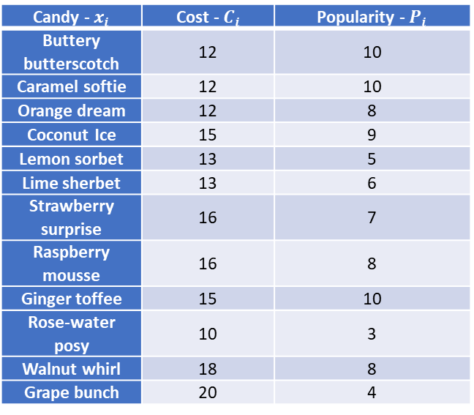
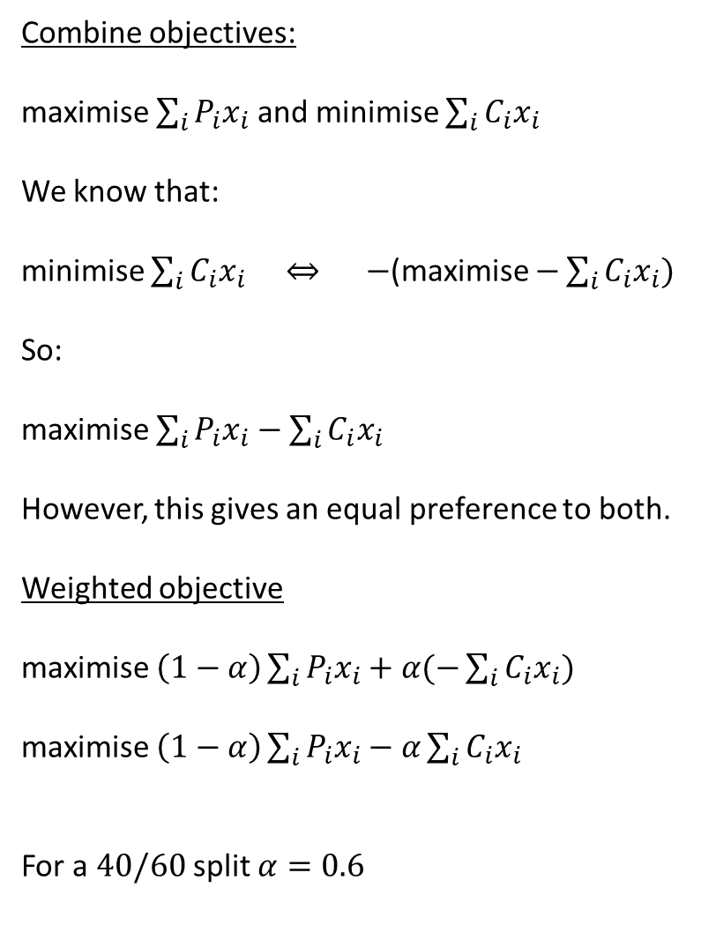
Weighted Objective
Combine objectives:
maximise $\sum_{i}{P_{i}x_{i}}$ and minimise $\sum_{i}{C_{i}x_{i}}$
We know that:
minimise $\sum_{i}{C_{i}x_{i}}$ $⇔ −$(maximise $−\sum_{i}{C_{i}x_{i}})$
So:
maximise $\sum_{i}{P_{i}x_{i}}−\sum_{i}{C_{i}x_{i}}$
However, this gives an equal preference to both.
Weighted objective
maximise $\left(1−α\right)\sum_{i}{P_{i}x_{i}}+α(−\sum_{i}{C_{i}x_{i}})$
maximise $\left(1−α\right)\sum_{i}{P_{i}x_{i}}−α\sum_{i}{C_{i}x_{i}}$
For a $40/60$ split (40% popularity, 60% cost) $α=0.6$
Candy - $x_{i}$ | Cost - $C_{i}$ | Popularity - $P_{i}$
Buttery butterscotch | 12 | 10
Caramel softie | 12 | 10
Orange dream | 12 | 8
Coconut Ice | 15 | 9
Lemon sorbet | 13 | 5
Lime sherbet | 13 | 6
Strawberry surprise | 16 | 7
Raspberry mousse | 16 | 8
Ginger toffee | 15 | 10
Rose-water posy | 10 | 3
Walnut whirl | 18 | 8
Grape bunch | 20 | 4
Issue
Cost and Popularity may be of a different scale
What if cost was in thousands of pounds?

Slide 22
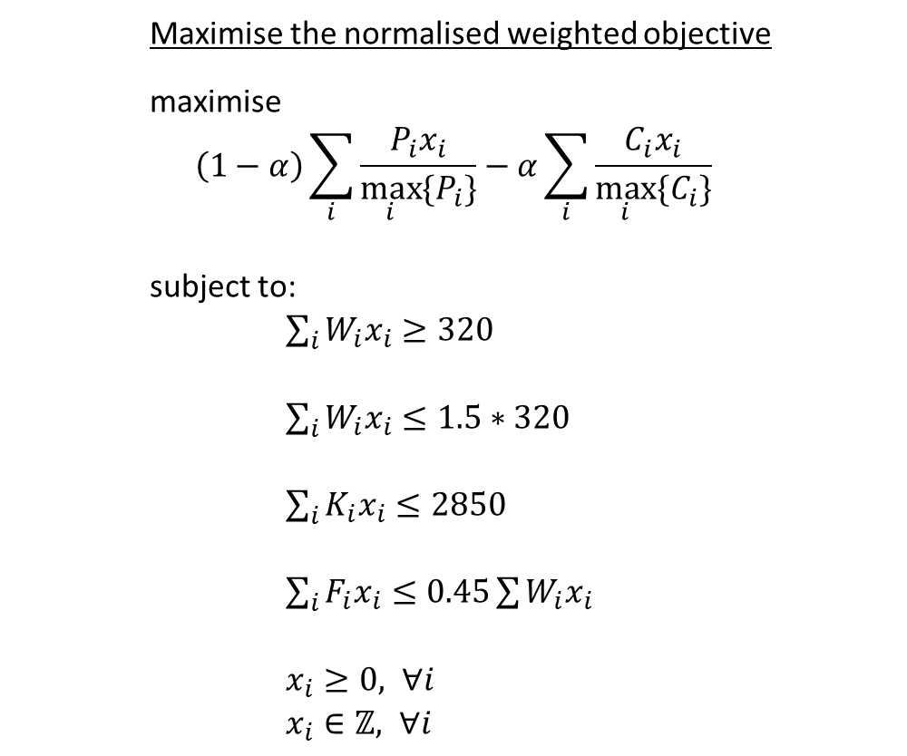
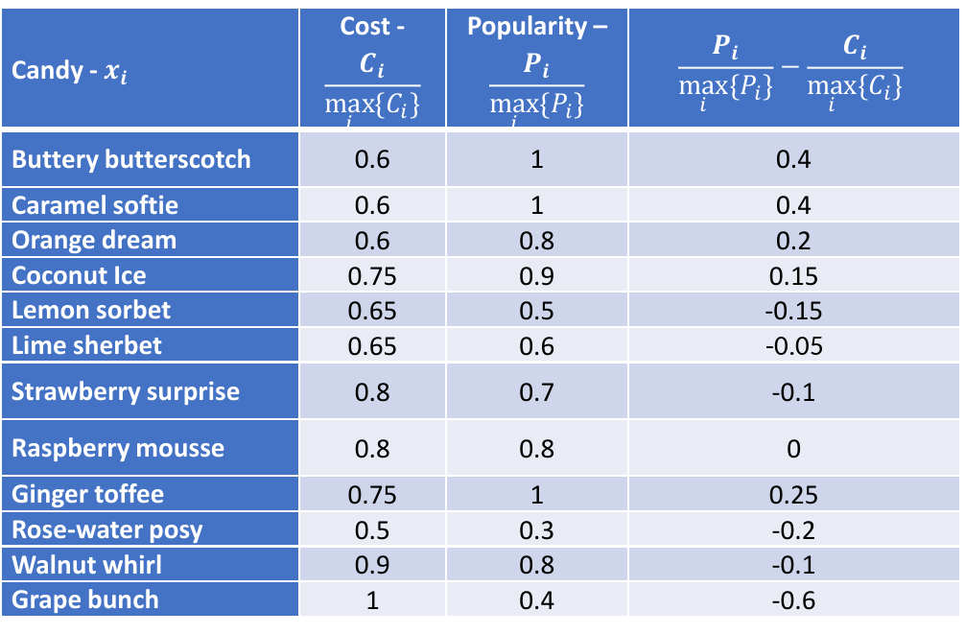
Normalised Data
Maximise the normalised weighted objective
maximise
$$\left(1−α\right)\sum_{i}{\frac{P_{i}x_{i}}{\max_{i}{\{P_{i}\}}}}−α\sum_{i}{\frac{C_{i}x_{i}}{\max_{i}{\{C_{i}\}}}}$$
subject to:
$\sum_{i}{W_{i}x_{i}≥320}$
$\sum_{i}{W_{i}x_{i}≤1.5∗320}$
$\sum_{i}{K_{i}x_{i}≤2850}$
$\sum_{i}{F_{i}x_{i}≤0.45\sum{W_{i}x_{i}}}$
$x_{i}≥0, ∀i$
$x_{i}∈ℤ, ∀i$
Candy - $x_{i}$ | Cost - $$\frac{C_{i}}{\max_{i}{\{C_{i}\}}}$$ | Popularity – $$\frac{P_{i}}{\max_{i}{\{P_{i}\}}}$$ | $$\frac{P_{i}}{\max_{i}{\{P_{i}\}}}−\frac{C_{i}}{\max_{i}{\{C_{i}\}}}$$
Buttery butterscotch | 0.6 | 1 | 0.4
Caramel softie | 0.6 | 1 | 0.4
Orange dream | 0.6 | 0.8 | 0.2
Coconut Ice | 0.75 | 0.9 | 0.15
Lemon sorbet | 0.65 | 0.5 | -0.15
Lime sherbet | 0.65 | 0.6 | -0.05
Strawberry surprise | 0.8 | 0.7 | -0.1
Raspberry mousse | 0.8 | 0.8 | 0
Ginger toffee | 0.75 | 1 | 0.25
Rose-water posy | 0.5 | 0.3 | -0.2
Walnut whirl | 0.9 | 0.8 | -0.1
Grape bunch | 1 | 0.4 | -0.6

Slide 23
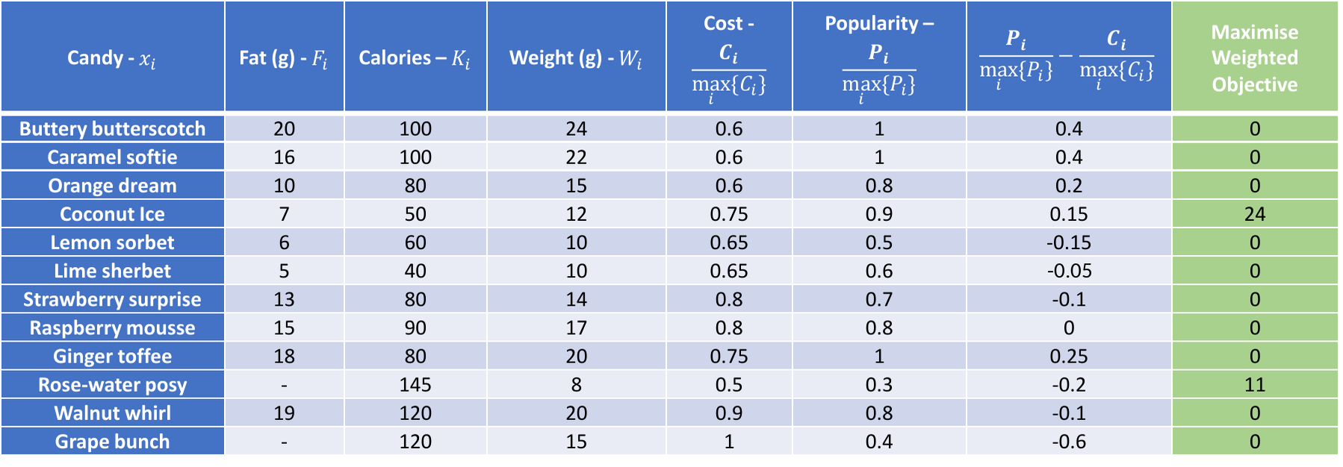

Result - Equal Preference $α=0.5$
Candy - $x_{i}$ | Fat (g) - $F_{i}$ | Calories – $K_{i}$ | Weight (g) - $W_{i}$ | Cost - $$\frac{C_{i}}{\max_{i}{\{C_{i}\}}}$$ | Popularity – $$\frac{P_{i}}{\max_{i}{\{P_{i}\}}}$$ | $$\frac{P_{i}}{\max_{i}{\{P_{i}\}}}−\frac{C_{i}}{\max_{i}{\{C_{i}\}}}$$ | Maximise Weighted Objective
Buttery butterscotch | 20 | 100 | 24 | 0.6 | 1 | 0.4 | 0
Caramel softie | 16 | 100 | 22 | 0.6 | 1 | 0.4 | 0
Orange dream | 10 | 80 | 15 | 0.6 | 0.8 | 0.2 | 0
Coconut Ice | 7 | 50 | 12 | 0.75 | 0.9 | 0.15 | 24
Lemon sorbet | 6 | 60 | 10 | 0.65 | 0.5 | -0.15 | 0
Lime sherbet | 5 | 40 | 10 | 0.65 | 0.6 | -0.05 | 0
Strawberry surprise | 13 | 80 | 14 | 0.8 | 0.7 | -0.1 | 0
Raspberry mousse | 15 | 90 | 17 | 0.8 | 0.8 | 0 | 0
Ginger toffee | 18 | 80 | 20 | 0.75 | 1 | 0.25 | 0
Rose-water posy | - | 145 | 8 | 0.5 | 0.3 | -0.2 | 11
Walnut whirl | 19 | 120 | 20 | 0.9 | 0.8 | -0.1 | 0
Grape bunch | - | 120 | 15 | 1 | 0.4 | -0.6 | 0
Selection has:
a total weight of 376g
2795 kcals
168g fat

Slide 24
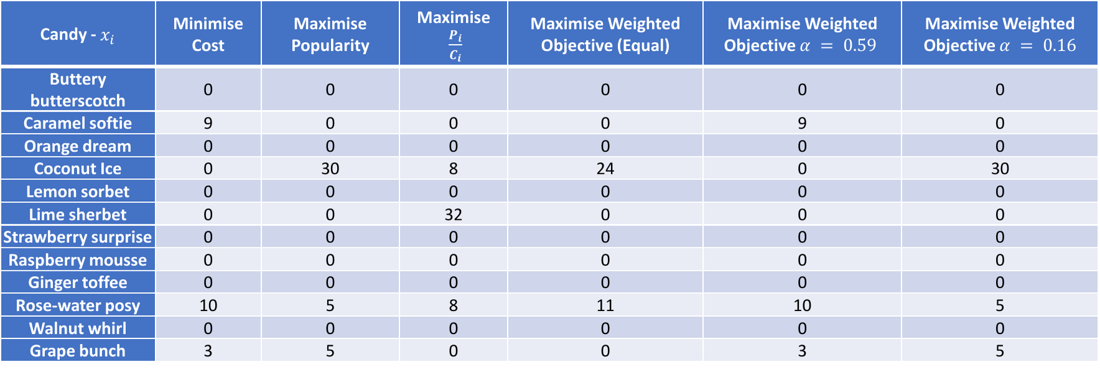
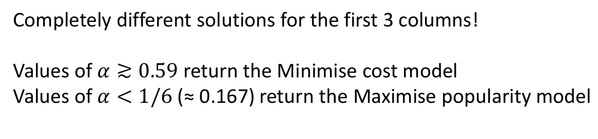
Results for all capped models
Candy - $x_{i}$ | Minimise Cost | Maximise Popularity | Maximise $\frac{P_{i}}{C_{i}}$ | Maximise Weighted Objective (Equal) | Maximise Weighted Objective $α = 0.59$ | Maximise Weighted Objective $α = 0.16$
Buttery butterscotch | 0 | 0 | 0 | 0 | 0 | 0
Caramel softie | 9 | 0 | 0 | 0 | 9 | 0
Orange dream | 0 | 0 | 0 | 0 | 0 | 0
Coconut Ice | 0 | 30 | 8 | 24 | 0 | 30
Lemon sorbet | 0 | 0 | 0 | 0 | 0 | 0
Lime sherbet | 0 | 0 | 32 | 0 | 0 | 0
Strawberry surprise | 0 | 0 | 0 | 0 | 0 | 0
Raspberry mousse | 0 | 0 | 0 | 0 | 0 | 0
Ginger toffee | 0 | 0 | 0 | 0 | 0 | 0
Rose-water posy | 10 | 5 | 8 | 11 | 10 | 5
Walnut whirl | 0 | 0 | 0 | 0 | 0 | 0
Grape bunch | 3 | 5 | 0 | 0 | 3 | 5
Completely different solutions for the first 3 columns!
Values of $α≳0.59$ return the Minimise cost model
Values of $α<1/6$ (≈ 0.167) return the Maximise popularity model

Slide 25
Solve the Linear Program First
Solve the Linear Program first, Integer Program second.
The LP’s optimal solution may already be whole numbers, i.e. you might just get lucky!
In that case you don’t need to solve the Integer Program (can be slow to solve for large models)

Slide 26
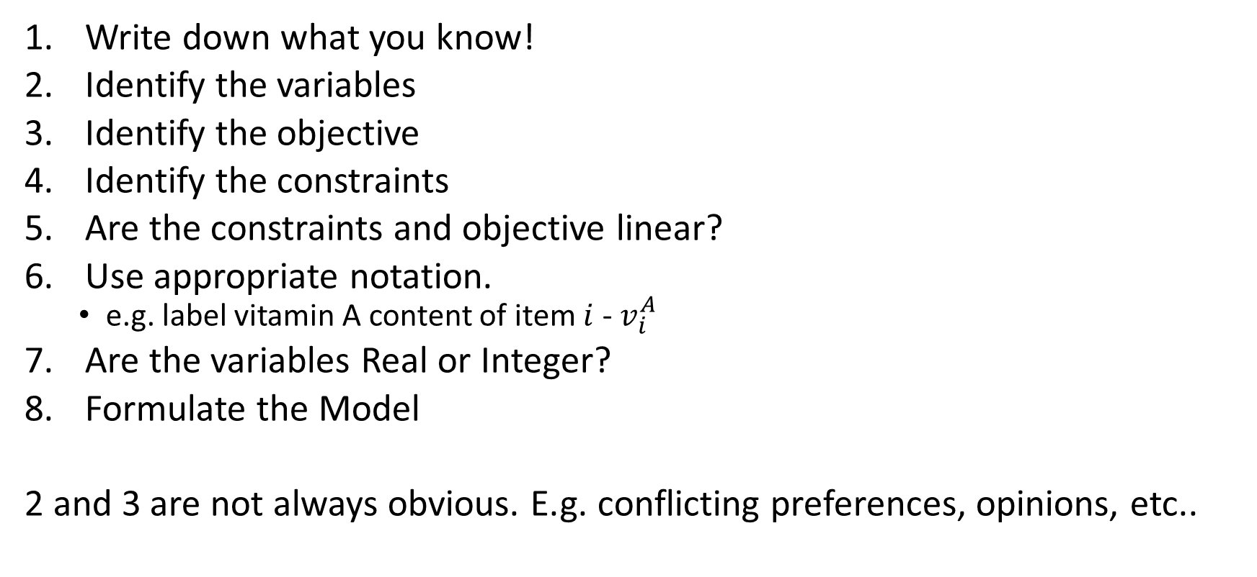
Modelling a Linear Program
Write down what you know!
Identify the variables
Identify the objective
Identify the constraints
Are the constraints and objective linear?
Use appropriate notation.
  e.g. label vitamin A content of item $i$ - $v_{i}^{A}$
Are the variables Real or Integer?
Formulate the Model
2 and 3 are not always obvious. E.g. conflicting preferences, opinions, etc.

Slide 27
Additional Tips
Model a Scaled/Simpler Problem
  It is easier to spot errors
Do you have test data?
  What if you already make a given profit and your model does worse?
Under Modelling
  Your model misses important features/constraints
Over Modelling
  Just like we extended, sometimes our models can be too restrictive
  We can also end up including redundant features/constraints
  We can also end up with conflicting constraints – Infeasible
    Sales wants more than can be produced
  Sometimes an expert knows best
Please have a read of the R.E.D. Woolsey articles. They are both insightful and amusing.
  We will go over the Inflexible Steel Company in another session

